Slide 1



GLOBAL SUPPLY CHAIN ANALYSIS
PROJECT GUIDE
Mr.M.Neelamegan
AP/AI
PROJECT MEMBER
Pradakshina.S.B(22ALR064)
Nithish.N(22ALR060)
Yogananth.J(22ALL123)

Slide 2
PROBLEM STATEMENT
In today's globalized economy, supply chains are becoming increasingly complex, spanning multiple countries and involving various stakeholders. This complexity leads to challenges such as limited visibility into real-time operations, difficulty in identifying potential risks, and inefficiencies in cost management and resource allocation.
Organizations struggle to make informed decisions due to fragmented data and a lack of centralized analytics. The aim of this analysis is to utilize Power BI to integrate and visualize global supply chain data, offering clear insights that enable better forecasting, risk mitigation, cost optimization, and more responsive supply chain management.

Slide 3
OBJECTIVE
The objective of this analysis is to leverage Power BI to create a comprehensive and interactive dashboard that provides real-time visibility into the global supply chain.
By integrating data from multiple sources, the goal is to identify bottlenecks, optimize inventory and logistics, mitigate risks, and enhance overall supply chain efficiency.
This will empower stakeholders to make data-driven decisions, improve operational performance, and respond swiftly to disruptions or changes in market demand.

Slide 4
DATASET LINK
https://www.kaggle.com/datasets/shashwatwork/dataco-smart-supply-chain-for-big-data-analysis
The dataset objective is to analyze the impact of shipping performance on customer satisfaction and behavior, as well as to examine category-wise sales performance and the benefit of orders.
The dataset contains information about shipping, customer behavior, sales, and benefits, and the goal is to create dashboards and measures in Power BI to answer various questions and gain insights into these areas.

Slide 5
PREPROCESSING
Data Collection: Dataset acquired from Kaggle for the DataCo Global Supply Chain analysis, containing CSV files with data on orders, customer demographics, shipment details, and product information.
Data Cleaning: Process involved handling missing values, removing duplicates, validating entries, and converting data types where necessary. Power BI's Power Query Editor was used for actions like replacing blanks with nulls and removing errors.
Data Transformation: Applied operations such as column splitting, replacing values, and formatting columns to prepare the dataset for analysis. Measures and calculated columns were created to enhance interpretability and usability for visualization.

Slide 6
PREPROCESSING
Data Modeling: Relationships were established between tables using primary and foreign keys (e.g., customer and product IDs) to enable connected data visualizations across various attributes in Power BI.
Data Standardization and Normalization: Data fields were standardized to ensure consistency across entries. This included normalizing fields like dates and regions to a consistent format, facilitating smoother integration and analysis within Power BI.
Error Handling and Outlier Detection: Outliers and inconsistencies were identified and addressed, either by replacing them with estimated values or removing them if they were extreme. This helped improve data accuracy and reliability, laying a solid foundation for meaningful analysis and insights.

Slide 7
QUESTIONS AND INFERENCES:
1.Solve for Total Sales per Region to determine sales distribution.
High sales in specific regions indicate strong market presence, while low sales suggest potential areas for targeted growth or marketing efforts.
2.Relate market share to the shopping category to assess market reach.
Categories with larger market shares show high customer demand or brand loyalty. This insight can guide stock levels or promotional focus on the most popular categories.
3.Sketch late delivery rates by product using stacked column charts to illustrate delivery performance.
Products with higher late delivery rates may need process improvements, possibly in inventory management or supplier coordination, to enhance customer satisfaction.

Slide 8
QUESTIONS
4.Use a geographical map to categorize and illustrate how total sales are distributed across regions.
Regions with concentrated sales demonstrate market dominance, while underserved areas might represent opportunities for expansion or improved distribution.
5.Complete a visualization of total sales by type to interpret sales patterns.
If certain sales types focus can shift to maximizing efficiency or enhancing customer experience in those channels.
6.Articulate filters or slicers by Region, Product Category, and Order Status to allow for focused exploration of specific areas.
Using filters or slicers helps stakeholders focus on specific regions, products, or order types, enabling customized insights and refined decision-making.

Slide 9
QUESTIONS
7.Identify and categorize the Top 5 Products by Sales in Each Region.
Smart watch,Perfect Fitness Perfect Rip Deck ,Toys,Nike Men's Free 5.0+ Running Shoe ,Hirzl Women's Hybrid Golf Glove
8.Calculate the total number of products to summarize inventory scale.
A high count indicates broad inventory but may incur higher holding costs. Optimal inventory size is crucial for cost management and meeting demand.
9.Distill total sales for each Order region using a map to contrast regional performance.
Regions with high total sales reflect active markets with strong demand, while lower sales regions may require different sales tactics or marketing approaches.

Slide 10
QUESTIONS
10.Distill Profit Margin by Product Category to analyze profitability.
Categories with high profit margins are key to revenue generation, suggesting areas to prioritize or promote. Low-margin items might be re-evaluated for pricing or cost adjustments.
11.Illustrate delivery status by category using a chart to contrast performance across categories.
Categories with low delivery success rates might benefit from improvements in logistics or supplier reliability to meet customer expectations.
12.Categorize customer segments by total sales and profit to discover key customer profiles.
Key customer profiles can be identified, helping target high-value customers or prioritize resources for profitable segments.

Slide 11
QUESTIONS
13.Relate the percentage of late deliveries by market using a chart to contrast punctuality.
High late delivery rates in certain markets suggest areas needing better supply chain coordination or enhanced service standards.
14.Devise a measure to calculate sales performance for each department.
Departments with strong sales performance contribute significantly to overall revenue, guiding resource allocation or departmental focus.
15.Compute and articulate the benefit per order for each category to evaluate profitability.
Categories with high benefits per order maximize revenue potential, highlighting profitable areas for marketing or sales efforts.

Slide 12
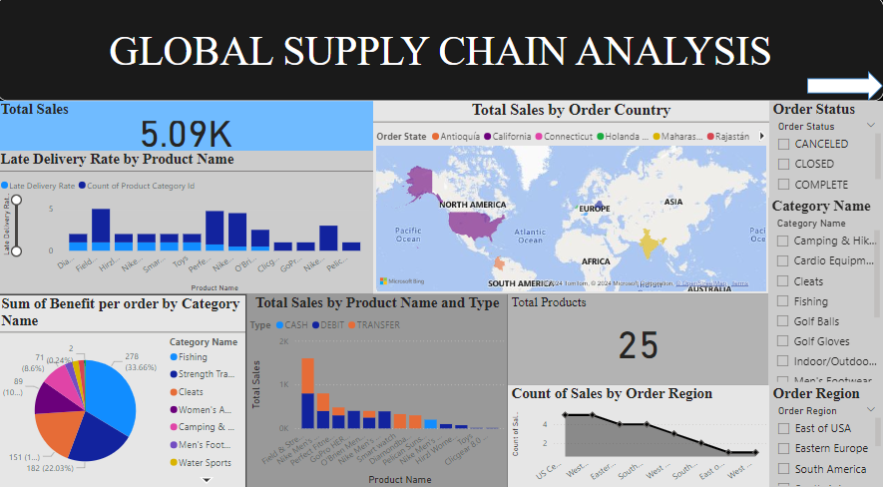
DASHBOARD

Slide 13
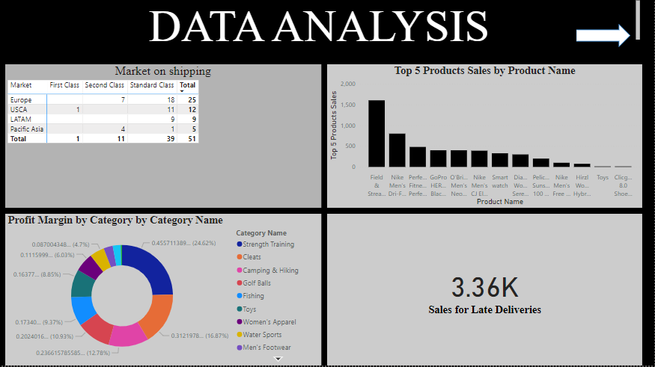
DASHBOARD

Slide 14
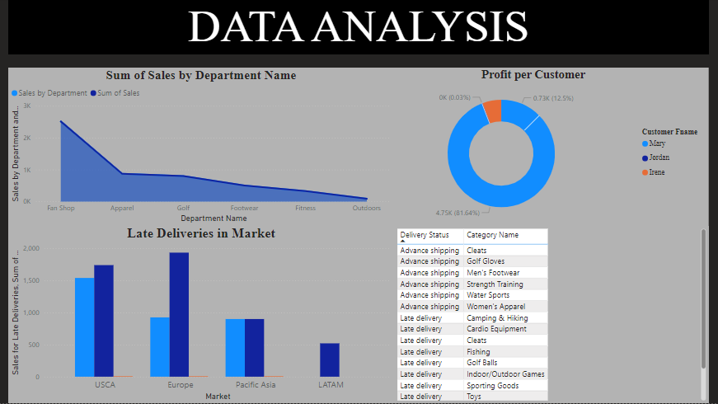
DASHBOARD

Slide 15
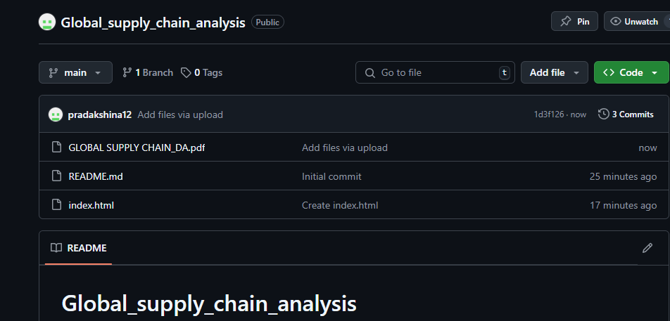
GITHUB LINK
https://github.com/pradakshina12/Global_supply_chain_analysis

Slide 16
REFERENCES
Astbury, B., and Leeuw, F.L. 2010. “Unpacking Black Boxes: Mechanisms and Theory Building in Evaluation.” American Journal of Evaluation 31(3): 363–81.
Belman, D.L., Monaco, K.A., and Brooks, T.J. 2005. Sailors of the Concrete Seas. East Lansing, MI: Michigan State University Press.
Calantone, R., Whipple, J.M., Wang, J.F., Sardashti, H., and Miller, J.W. 2017. “A Primer on Moderated Mediation Analysis: Exploring Logistics Involvement in New Product Development.” Journal of Business Logistics 38(3): 151–69.
Cantor, D.E., Celebi, H., Corsi, T.M., and Grimm, C.M. 2013. “Do Owner-Operators Pose a Safety Risk on the Nation's Highways?” Transportation Research Part E 59(1): 34–47.
Cantor, D.E., Corsi, T.M., and Grimm, C.M. 2006. “Safety Technology Adoption Patterns in the U.S. Motor Carrier Industry.” Transportation Journal 45(3): 20–45.

Slide 17
THANK YOU

